Slide 1
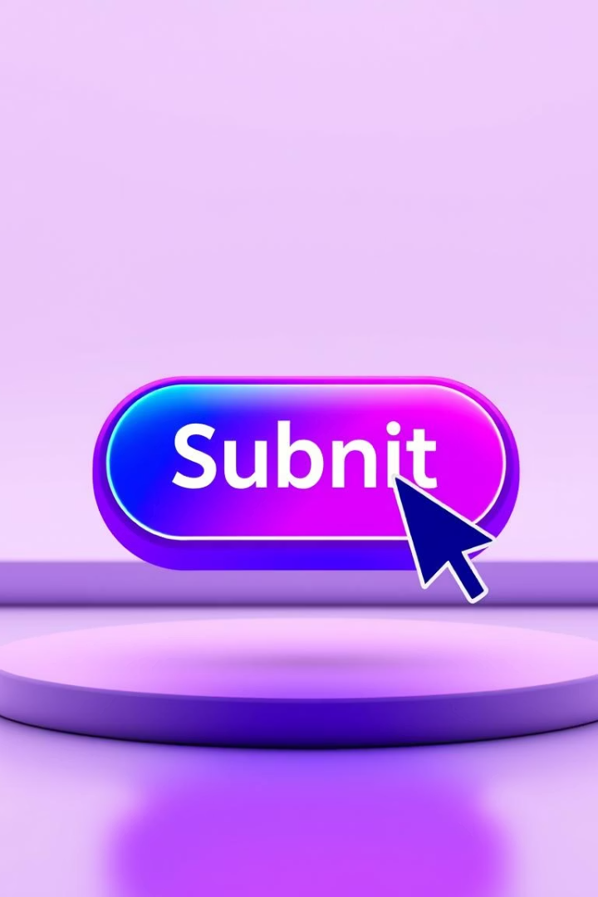
Day 4: Bringing Websites to Life with CSS Animations
Transitions, Animations & Transformations

Slide 2

Recap of Day 3
Positioning Review
Layout Methods
Recap of relative, absolute, fixed, and sticky positioning.
Comparison of Flexbox versus Grid layouts.
Responsive Design
Understanding media queries for responsive layouts.

Slide 3
Introduction to CSS Transitions
What Are Transitions?
Key Properties
Smoothly animate changes in CSS properties. Triggered by user actions like hover or focus.
transition-property (what to animate)
transition-duration (how long, e.g., 0.5s)
transition-timing-function (ease, linear)
transition-delay (when to start, e.g., 0.2s)

Slide 4

Advanced Transition Effects
Multi-Property Transitions
Common Use Cases
Used for button hovers, card lifts, and menu fades.
Animate multiple CSS properties simultaneously for complex effects.
Exercise
Create a "hover-to-enlarge" effect on an image.

Slide 5





CSS Transformations
Translate (Move)
Scale (Resize)
Rotate (Spin)
Modify an element’s position in 2D/3D space.
Enlarge or shrink an element.
Turn an element by a specified degree.
Skew (Tilt)
Tilt an element sideways.

Slide 6


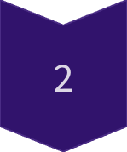
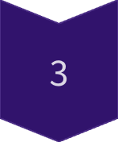
Keyframe Animations
What Are Animations?
Complex, multi-step animations with full control over each stage.
Animation Properties
Control duration, timing, delay, iteration count, and direction.
Example
A bouncing ball animation demonstrates keyframe usage.

Slide 7

Combining Transitions & Animations
Transitions
Animations
Simple effects (hover, focus)
Complex, multi-step movements
Single-state changes
Looping, continuous motion

Slide 8

Performance Tips
Use transform and opacity for smooth, GPU-accelerated animations.
Avoid animating margin, width, or height to prevent layout reflows.
Use will-change: transform; for optimization, preparing the browser for animation.

